Slide 1


EMPLOYEES ATTRITION INSIGHTS
A DATA-DRIVEN APPROACH FOR HR STRATEGY
PRESENTATION DEC, 2024
Analyzing Trends and Key Factors to Enhance Retention and Organizational Performance
Presented By:
Ali Sherif

Slide 2

AGENDA
1
Overall Attrition
2
Attrition by some specifications
3
Average Environment Satisfaction by Distance
4
Income vs. Attrition for Employees some levels (R&D)
5
Attrition by Salary Category
6
The Influence of Age on Attrition
7
Key Takeaways
8
Suggested Solutions

Slide 3

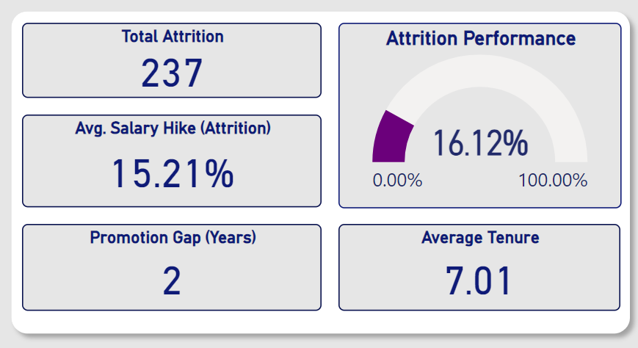
OVERALL ATTRITION
KEY INSIGHTS

Slide 4
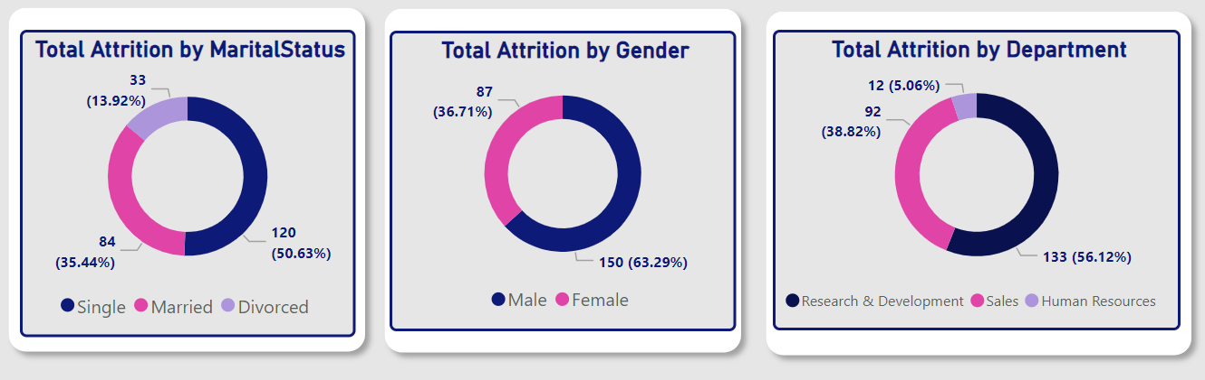
ATTRITION BY SOME SPECIFICATIONS
R&D has the highest attrition rate (56.12%)

Slide 5
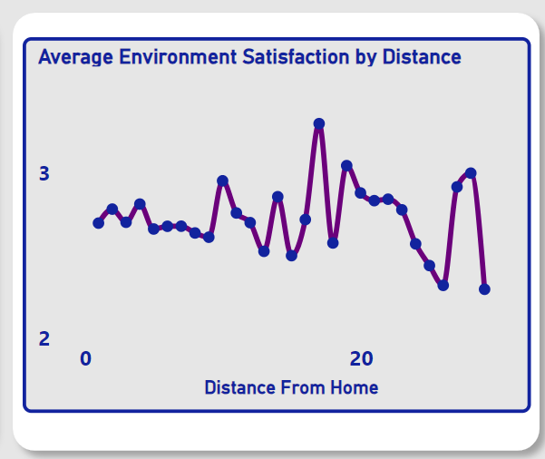
AVERAGE ENVIRONMENT SATISFACTION BY DISTANCE
The graph shows no clear correlation between environment satisfaction and distance from home, suggesting that distance isn’t a major factor in attrition.

Slide 6
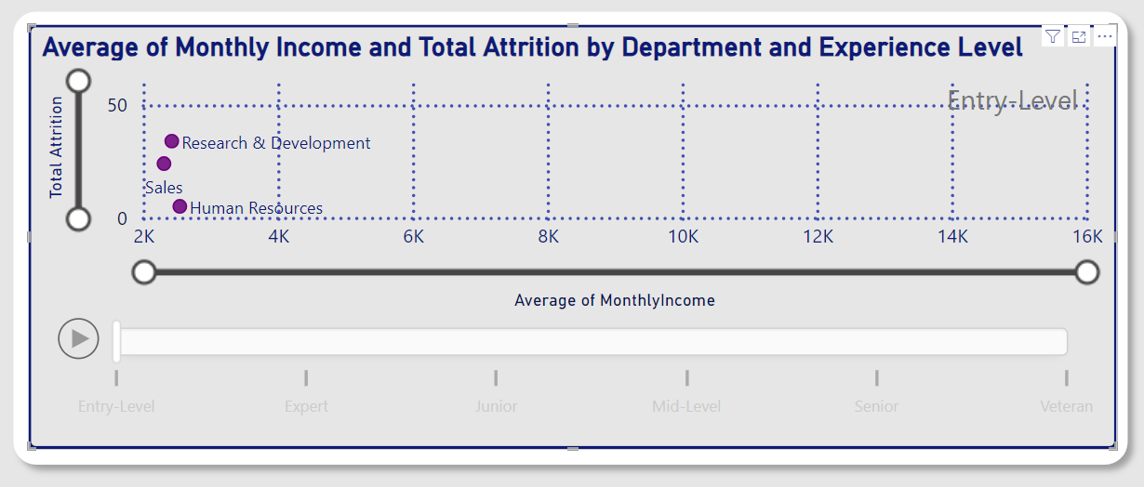
INCOME VS. ATTRITION FOR EMPLOYEES SOME LEVELS (R&D)
For Entry-Level

Slide 7
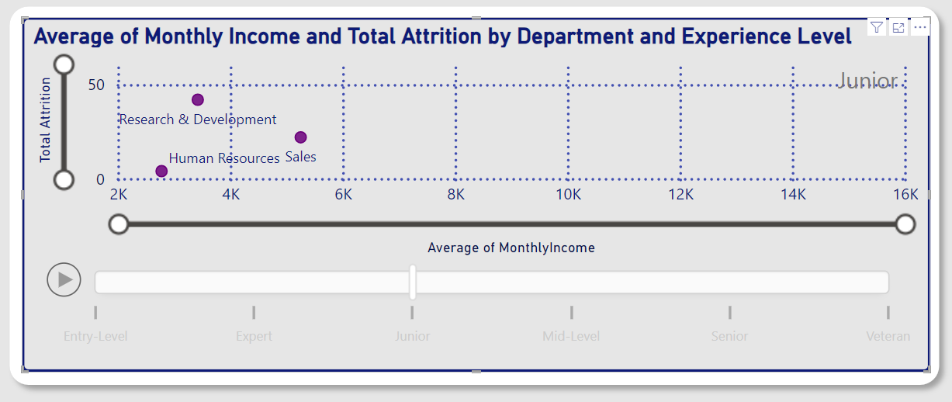
INCOME VS. ATTRITION FOR EMPLOYEES SOME LEVELS (R&D)
For Junior
The increase in attrition from entry-level to junior positions in the R&D department is likely because junior employees are seeking more experience and career growth, which may lead them to companies offering better opportunities, higher compensation, or more challenging projects.

Slide 8
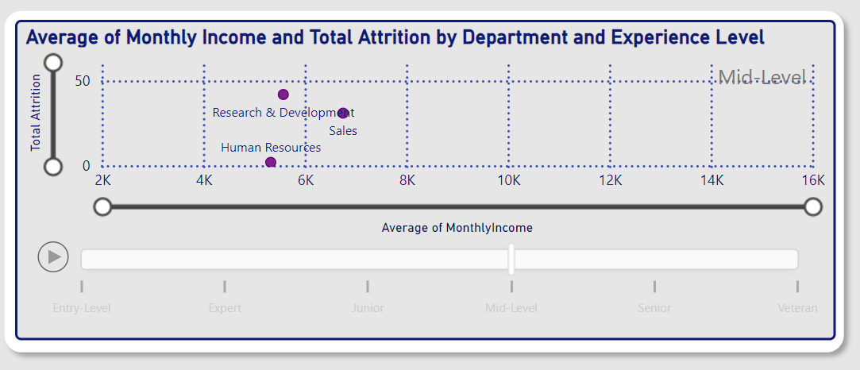
INCOME VS. ATTRITION FOR EMPLOYEES SOME LEVELS (R&D)
For Mid-Level
The decrease in attrition at mid-level positions suggests that employees may have found more stability or opportunities for growth within the company, reducing their likelihood of seeking opportunities elsewhere.

Slide 9
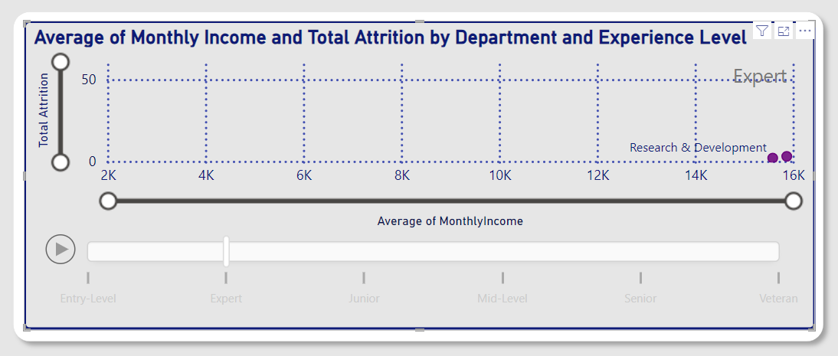
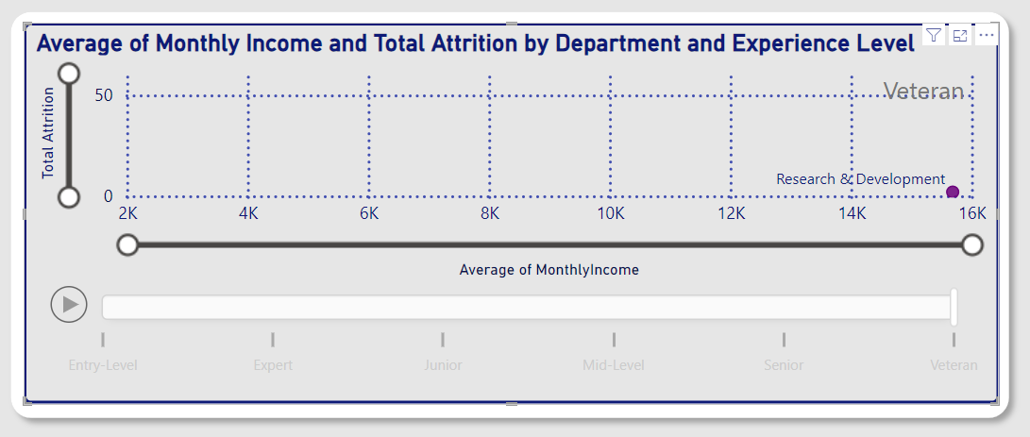
INCOME VS. ATTRITION FOR EMPLOYEES SOME LEVELS (R&D)

Slide 10
INCOME VS. ATTRITION FOR EMPLOYEES SOME LEVELS (R&D)
High Attrition at Junior/Entry Levels: Due to the need for specialized knowledge, employees seek better growth opportunities.
Decreasing Attrition at Senior/Expert Levels: As experience increases, employees stay due to accumulated expertise and career stability.
Low Attrition in Veterans: Veterans tend to stay for continued learning rather than career advancement.
Sales & HR Comparison: These departments experience lower attrition as they require less specialized knowledge, so employees are less likely to leave.

Slide 11
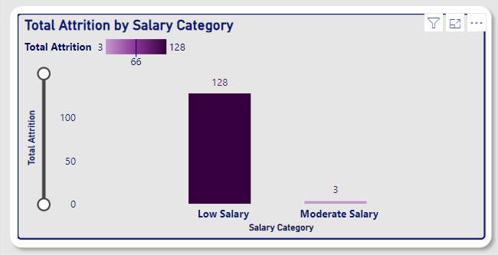
ATTRITION BY SALARY CATEGORY
For Entry-Level and Junior
The higher attrition rates among low-salary employees highlight the importance of competitive compensation for retention, especially at entry and junior levels.

Slide 12
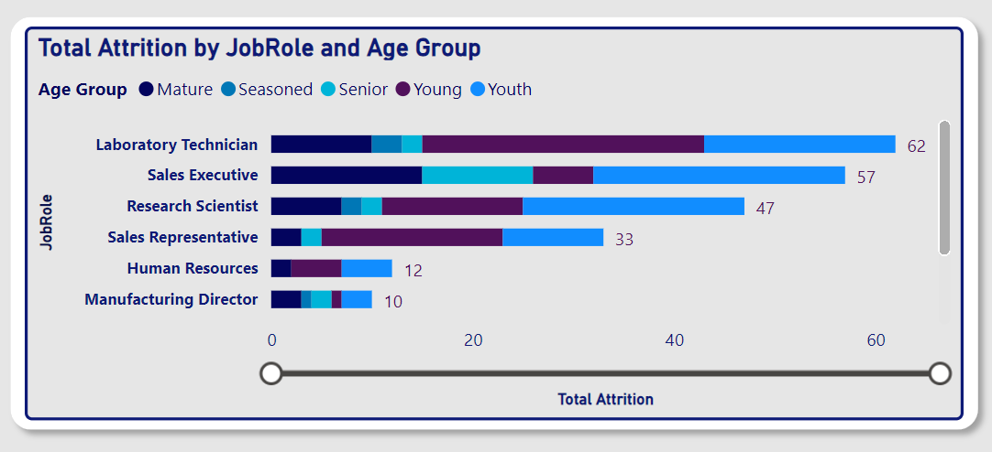
THE INFLUENCE OF AGE ON ATTRITION
Younger employees (both young and youth) tend to have higher attrition, particularly in roles with lower salaries.
Mature employees in certain departments like R&D also exhibit higher attrition, possibly due to limited career progression.

Slide 13

KEY TAKEAWAYS
High Attrition
Due to career progression and fewer advancement
In
Lower-Salary Roles
In
Younger Employees

Slide 14

SUGGESTED SOLUTIONS
Enhance compensation for low-salary roles, especially for younger employees.
Create clear career progression paths and upskilling programs.
Implement mentorship and development plans for entry-level employees.
Boost employee engagement through recognition and team-building.
Provide leadership development and retention bonuses for experienced employees.
Ensure growth opportunities and cross-functional collaboration in specialized roles like R&D.
Develop age-specific retention strategies focusing on career development and competitive compensation.

Slide 15
THANK YOU
FOR YOUR ATTENTION AND PARTICIPATION

